Slide 1
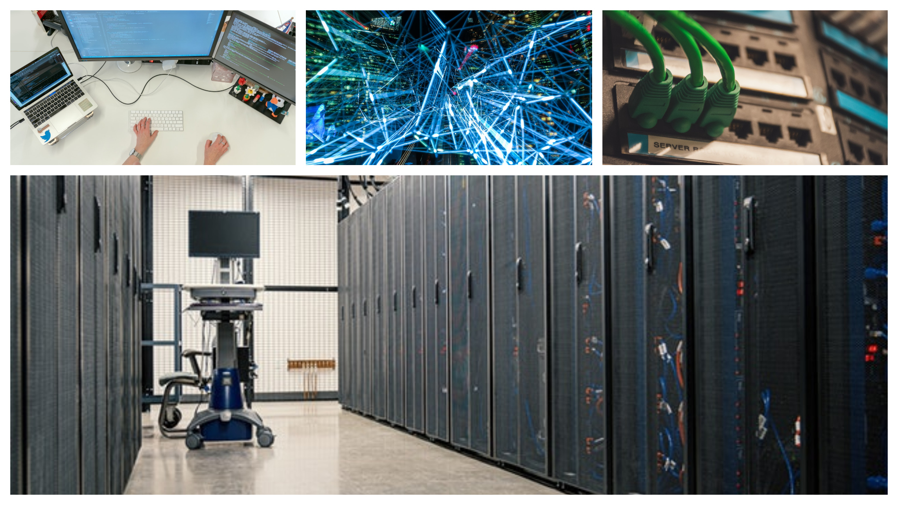
CompTIA
Network+

Slide 2
Networks Terms
Notes:
ID=d924773e-9a16-4d6d-9803-8cb819e99682
Recipe=text_billboard
Type=TextOnly
Variant=0
FamilyID=AccentBoxWalbaum_Zero

Slide 3
Network

Slide 4


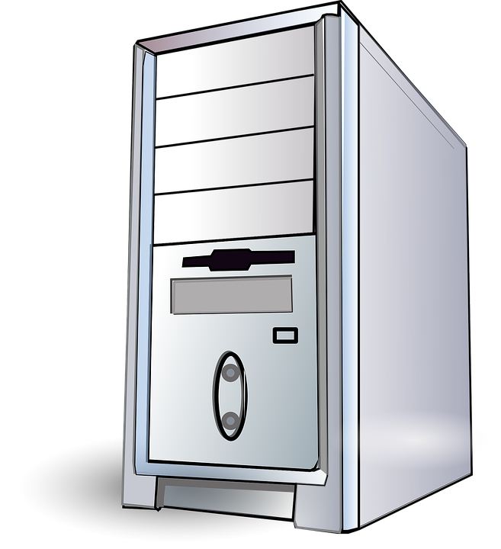
Workstation
Client
Server

Slide 5
Host
TCP/IP

Slide 6
Servers Roles
File Server
Print Server
Web Server
Mail Server
Proxy Server

Slide 7
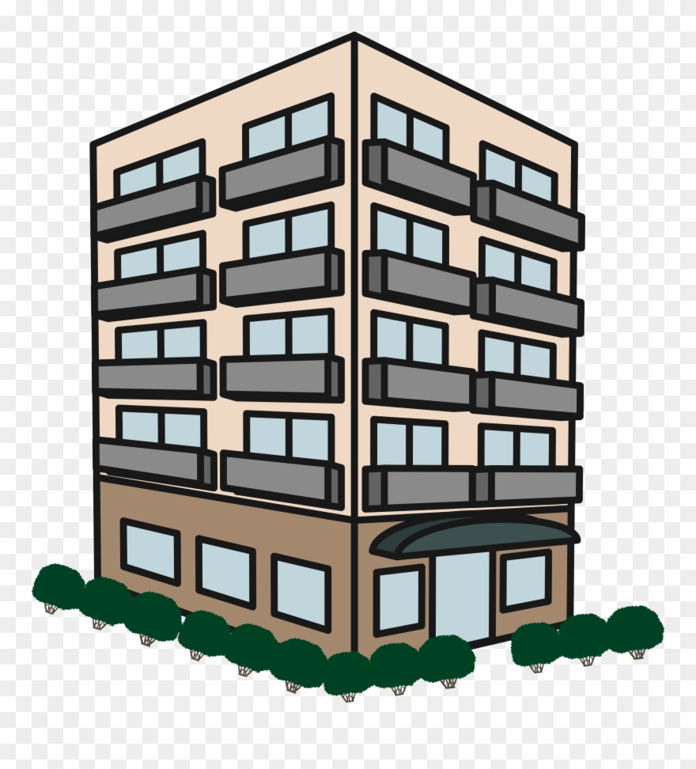
3
1
1 ABC Street.
ABC Street
2 ABC Street.
2

Slide 8

5
3
1
1 ABC
ABC
2 ABC
4
2

Slide 9
1
3
3
1
2
XYZ Street
ABC Street
1 ABC Street.
2
1 XYZ Street.

Slide 10
Router
5
1
3
1
Subnet
3
XYZ
2
ABC
Subnet
4
4
1 ABC
2
1 XYZ

Slide 11
LAN
LAN

Slide 12
LAN
LAN

Slide 13
Subnets
Subnets

Slide 14
LAN
LAN
internetwork

Slide 15



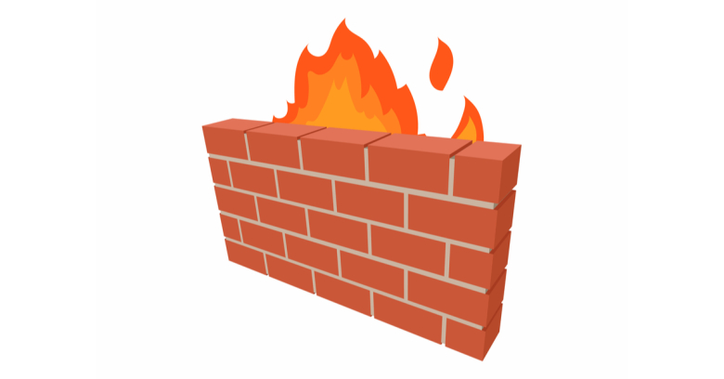

Internet
(Public Network)
(Private Network)
Firewall
LAN

Slide 16
Internet
LAN
Intranet

Slide 17

Internet
LAN
Extranet

Slide 18
IPv4

Slide 19

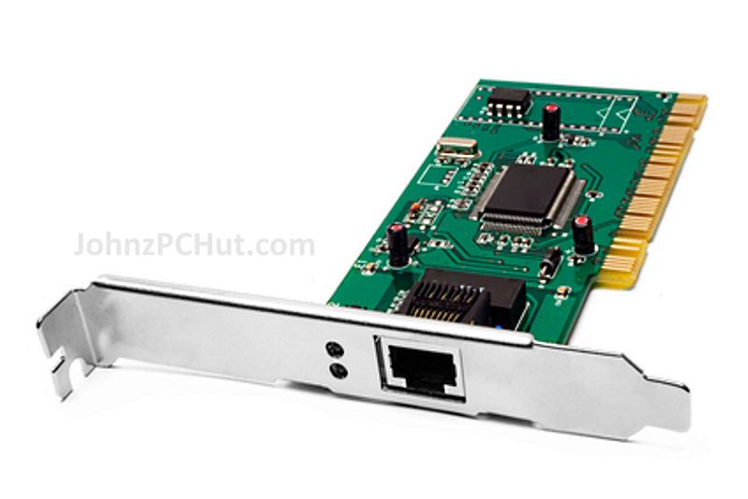

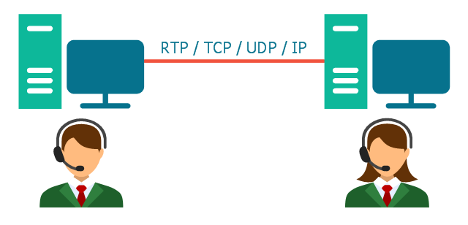
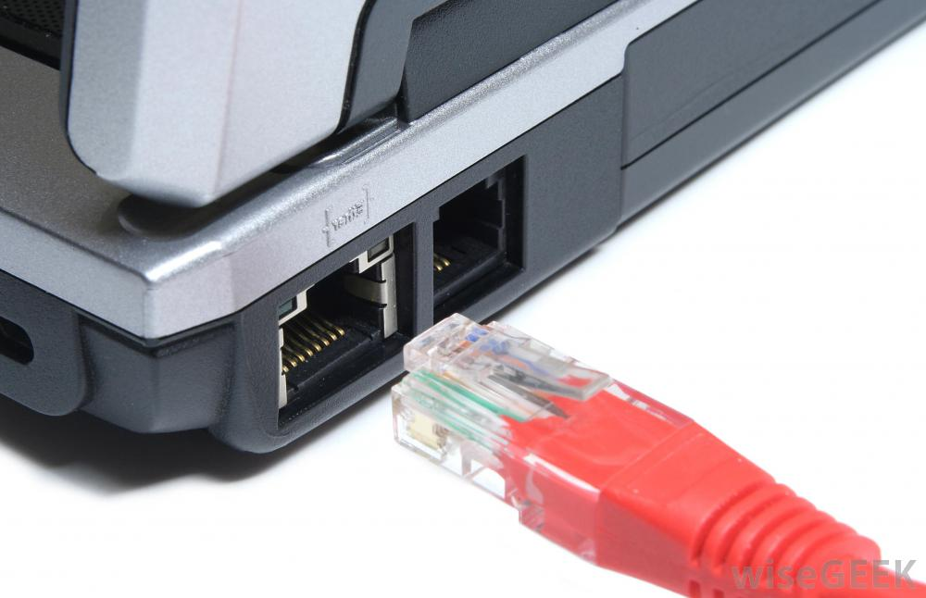
The Network Components
Any network must have 4 components:
Computer Systems
Network Media
Network Interface
Network Protocol

Slide 20
Network Address
Host Address
192
168
1
5
IP
Octet
Subnet
Mask
255
255
255
0
0-255

Slide 21
MAC Address

Slide 22
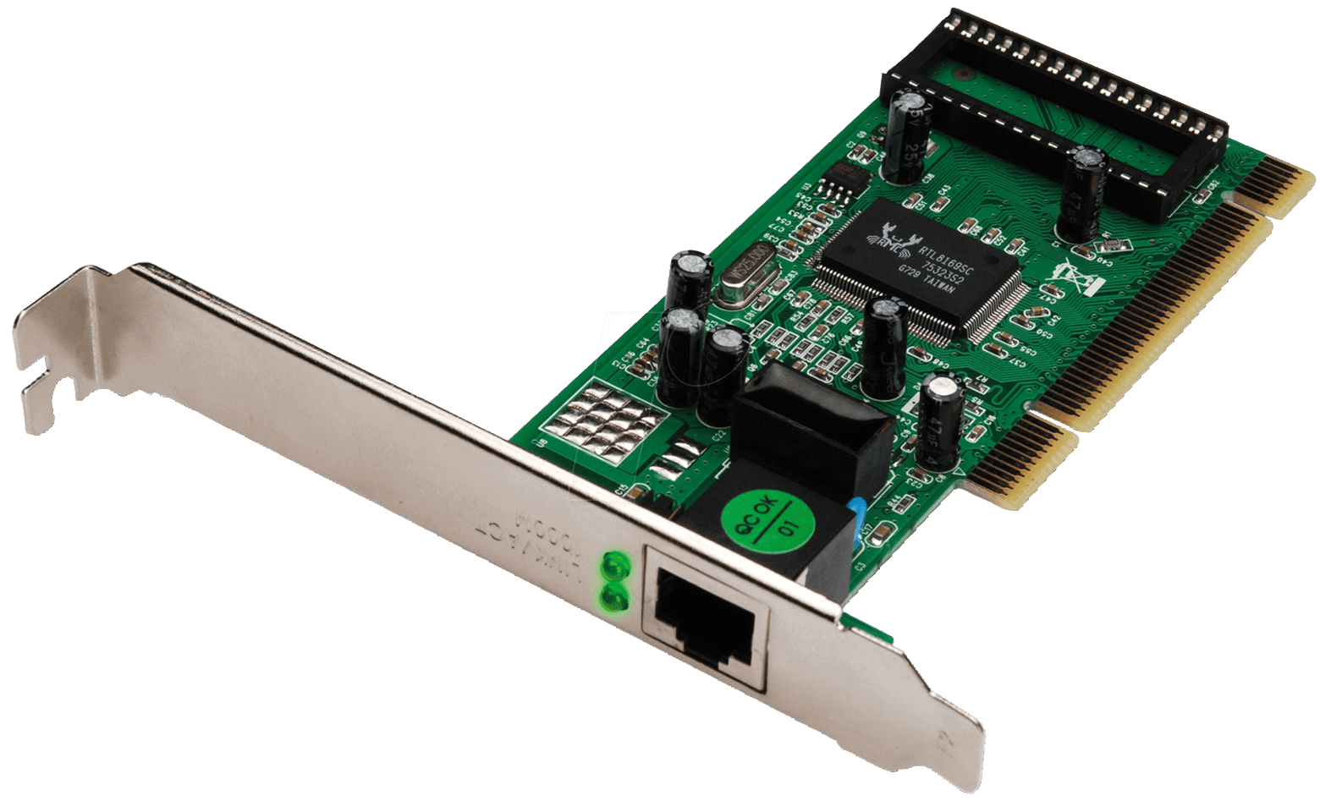
MAC Facts
MAC stands for Media Access Control
Is a physical address
Written in Hexa-Decimal format

Slide 23
00 -1C - 2F - 06 - CD - AE
0 - 9
A - F

Slide 24
00 – 1C – 2F – 06 – CD - AE
Organizationally Unique Identifier (OUI)
Network Interface Controller (NIC) Specific

Slide 25
Lab #1

Slide 26

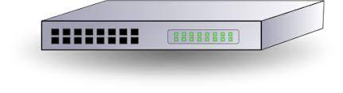
Lab #1
Name:
Client1-PC
Name:
Client2-PC
IP Address:
192.168.1.2
IP Address:
192.168.1.3

